Slide 1
Dependency Injection
Dependency Injection is a set of software design principles and patterns that enable us to develop loosely coupled code.
DI is a programming technique which states that we DO NOT have to create our dependencies, instead we have to INJECT them in our classes from outside through interfaces.
DI is an implementation part of Dependency Inversion Principle which states that High-level modules SHOULD NOT depend on low-level modules. Both SHOULD depend on abstractions.

Slide 2
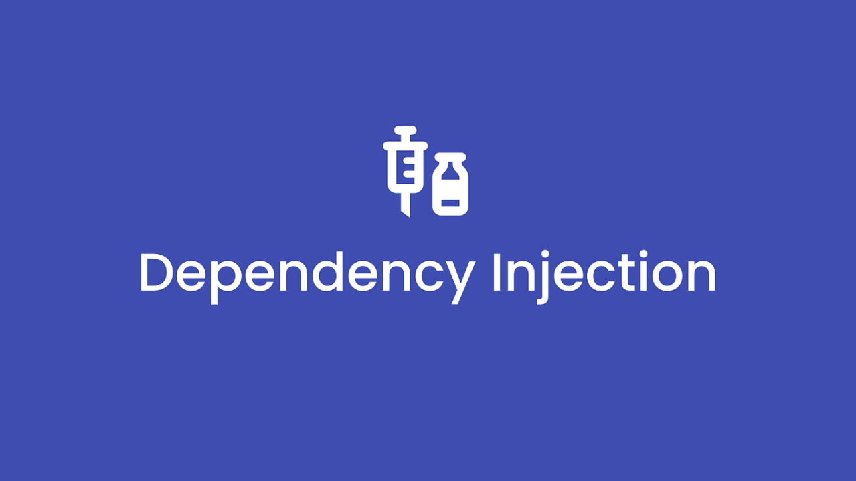
Benefits of Dependency Injection
Maintainability
Extensibility
Testability
Loose Coupling
Code Reusability
Late Binding
Parallel Development
Important Note: Every software developer that writes Object-Oriented Code SHOULD use dependency injection.

Slide 3

Why Tightly Coupled code is BAD EVIL?
NOT Flexible
NOT Maintainable
NOT Testable
NOT Scalable
Poor separation of concerns

Slide 4
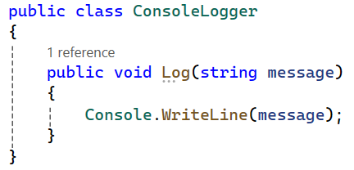
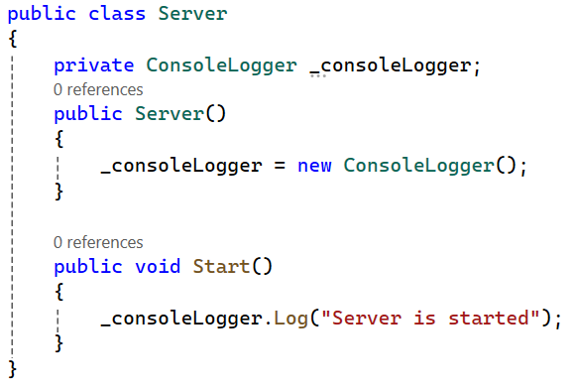
1. Tightly coupled code (Server Logging)
Do not program like this!

Slide 5
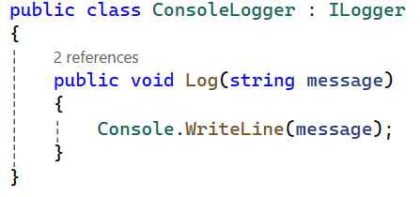
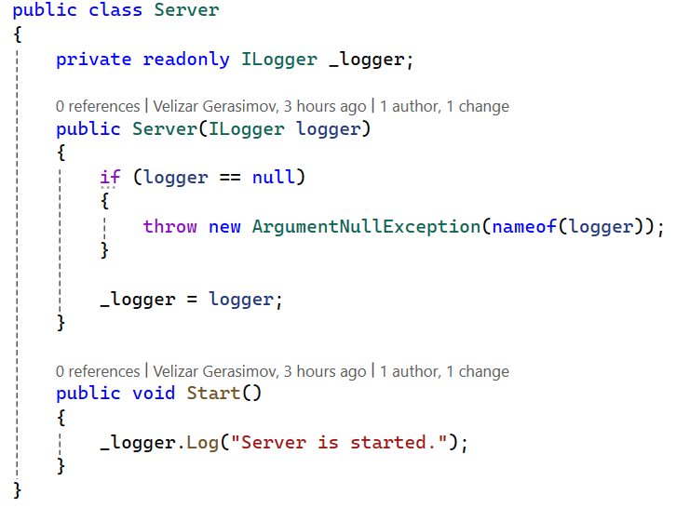
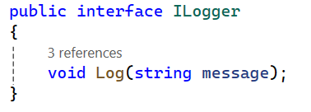
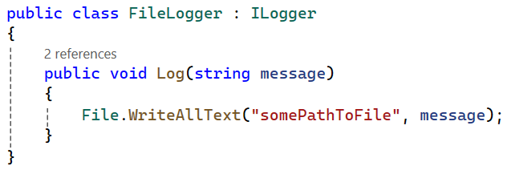
1. Loosely coupled code (Server Logging)
Constructor injection
implements
implements
This class now can work with any logger that implements ILogger interface: ConsoleLogger, FileLogger, DatabaseLogger, etc.

Slide 6
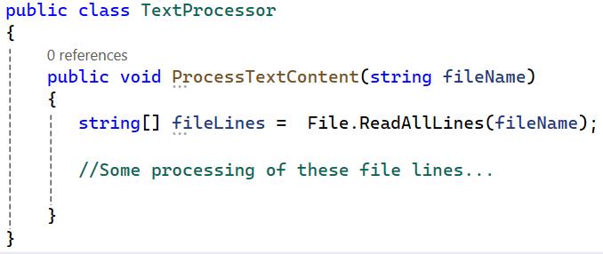
2. Tight Coupled Code (File System Abstraction)
Important Note: TextProcessor class is tight coupled to the file system. Now this class is not unit testable in the full sense of unit testing as isolated unit of code.

Slide 7
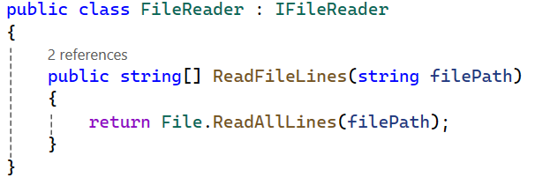
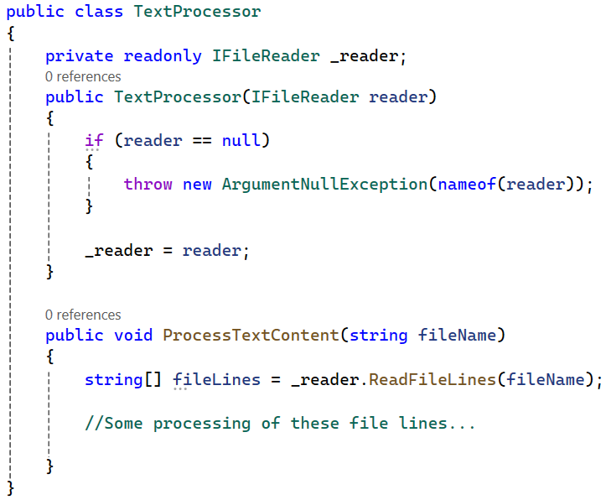
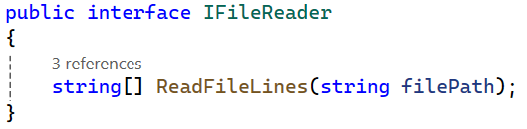
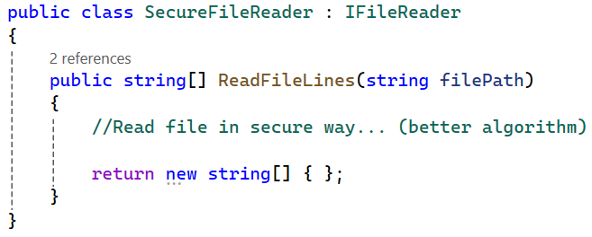
2. Loose Coupled Code (File System Abstraction)
implements
Constructor injection
implements

Slide 8
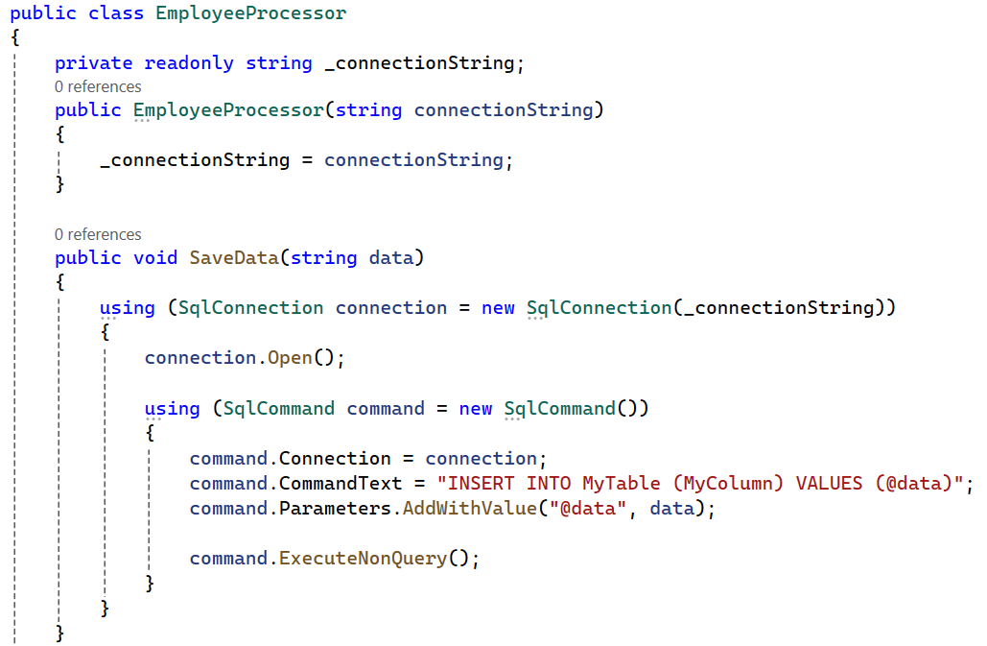
3. Tight Coupled Code (Database System Abstraction)
Important Note: EmployeeProcessor class is tight coupled to the database system. Now this class is not unit testable in the full sense of unit testing as isolated unit of code. If we try to test it we have to run real queries to our existing database.

Slide 9
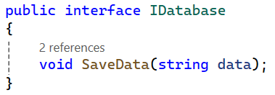
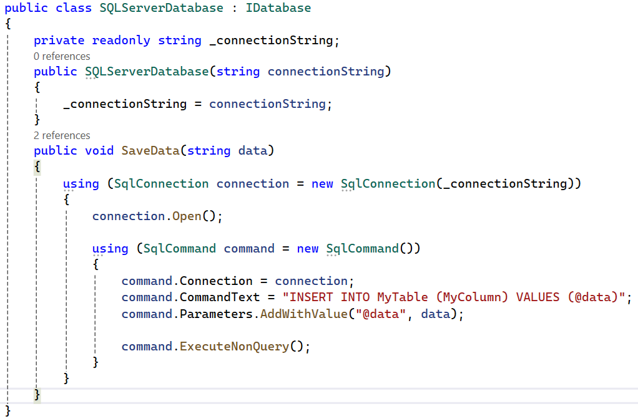
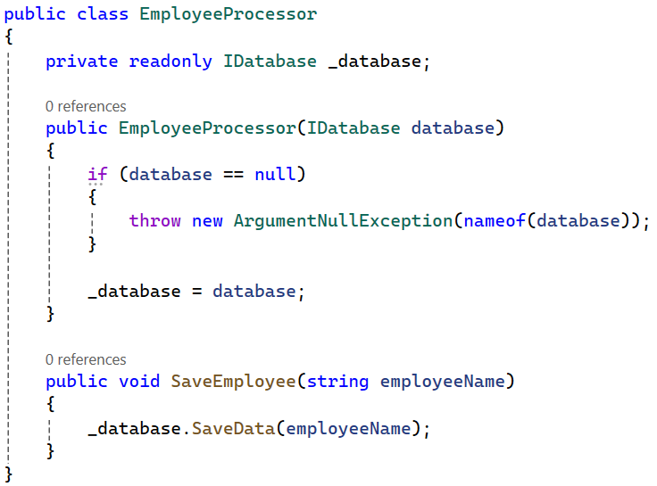
3. Loose Coupled Code (Database System Abstraction)
implements
Constructor injection

Slide 10
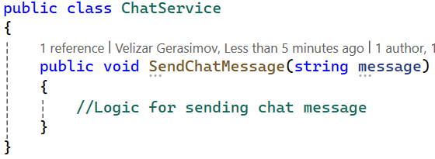
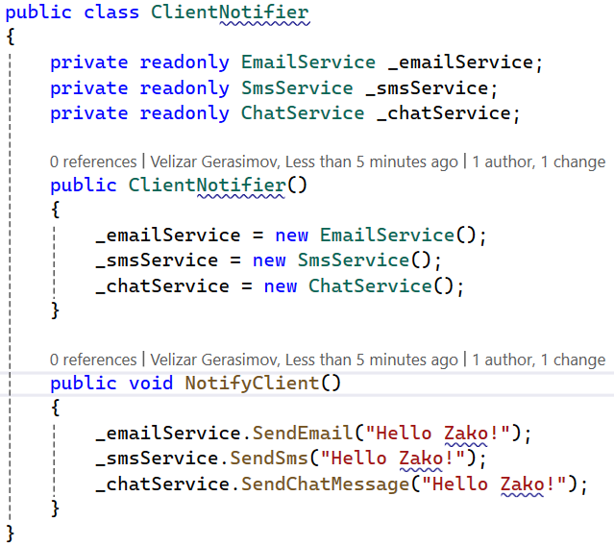
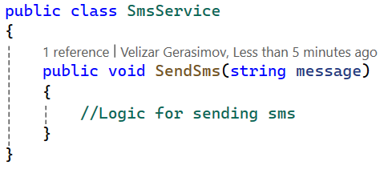
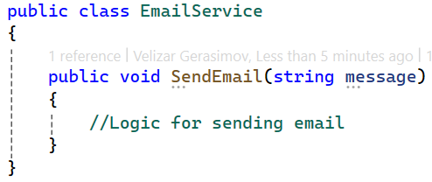
4. Tight Coupled Code (Client Notifier)

Slide 11
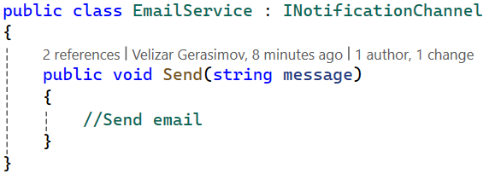
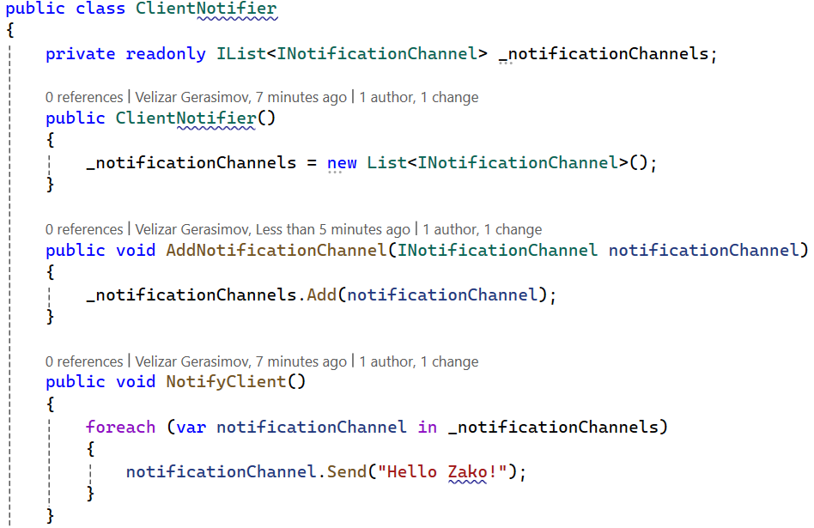
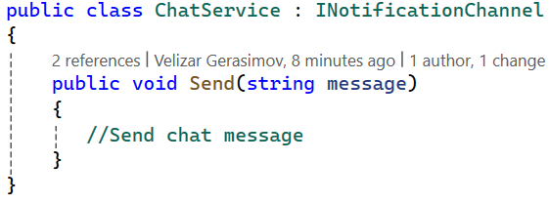
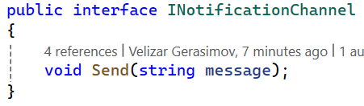
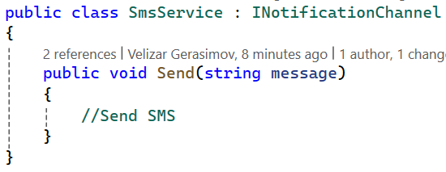
4. Loose Coupled Code (Client Notifier)
implements
implements
implements

Slide 12
Suggestions
If your project is not started with DI and is not so big, change it to support Dependency Injection. This will give you easier times when the project grows, and your architecture will be better. The code will become testable as well.
If you start a new project, have in mind how the code will be extended, maintained and tested. This will help you to design your application. For sure use Dependency Injection. Some engineers use Test Driven Development (TDD).
If your application is big, use DI Container framework like Autofac or some other framework. .NET has also build in light weight DI Container. The DI Container will help you to resolve your dependencies and to do not make complex, and at some point, unmaintainable dependency graph.

